Slide 1
Effect of Vaccination and total tests on total cases on worldwide panel data using FE model
Presented by GROUP 2
NAGA MADHULATHA RAMABHOTLA
Leo montano
Newlin nishia rubin
Shruti Khanna
Chitranshi Narayan
Vagdevi Anantha Lakshmi Tanmaye Potturu
Jayesh rathore
Harpreet Dhaliwal

Slide 2
Introduction
Panel data: A dataset in which the behavior of entities are observed across time which implies both cross-sectional and time series dimension
A balanced panel is a dataset in which each panel member (i.e., person) is observed every year
Drawbacks: data collection, micro-panels-nonresponse, macro-panels dependency

Slide 3

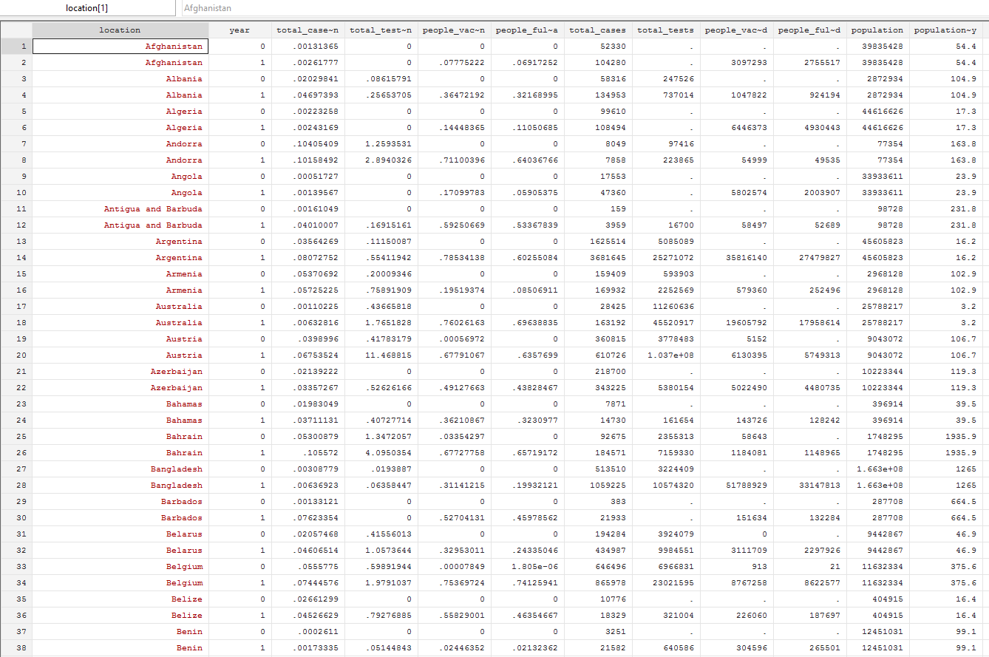
Sample of Panel data used in project

Slide 4
Analyzing Panel data
Panel Data
Controls
Fixed Effect Model
Bias

Slide 5
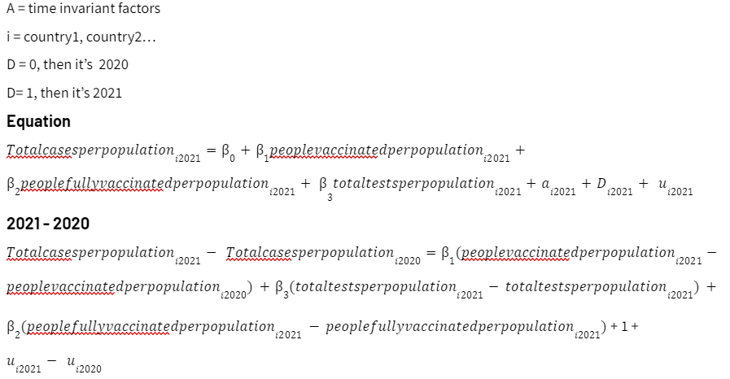
Fixed Effects Model

Slide 6
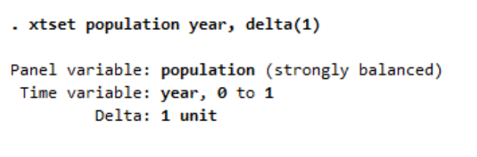
Stata results
2 basic commands are used in running FE model
xtset used to set Stata to handle panel data
xtreg is used to run fixed effects model
Note: Robust is added in xtreg to control for heteroskedasticity

Slide 7
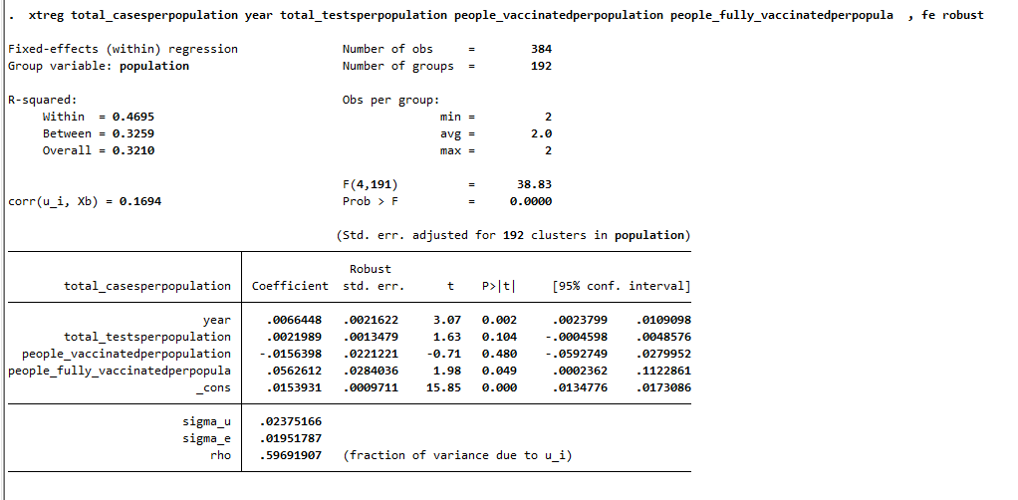
FE model results in stata
The errors ui are correlated with the regressors in the fixed effects model
If this number is < 0.05 then model is ok. This is a test (F) to see whether all the coefficients in the model are different than zero.
Coefficients of the regressors. Indicate how much Y changes when X increases by one unit.
59.7% of the variance is due to differences across panels.

Slide 8
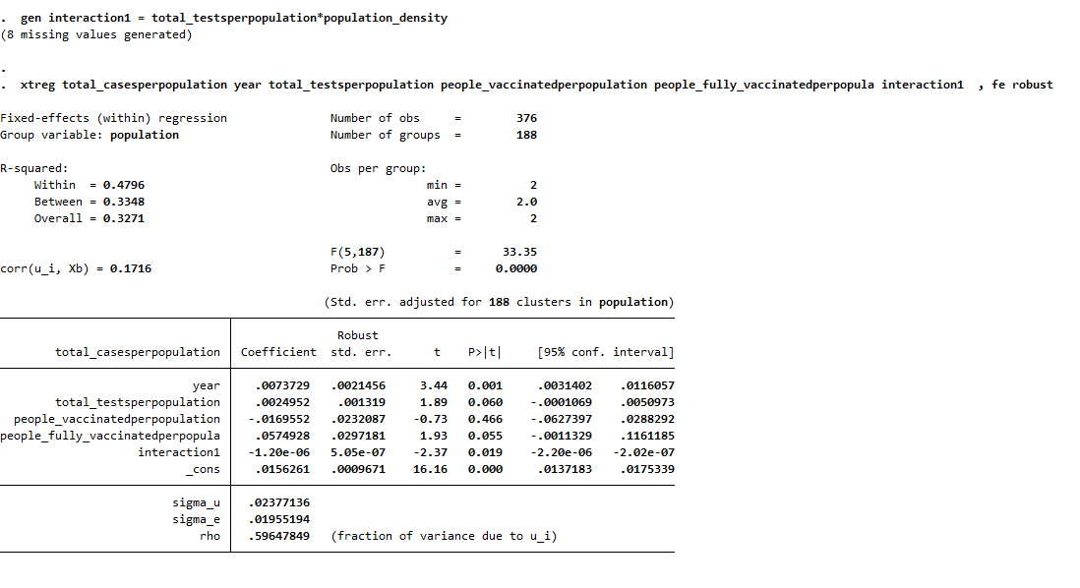
Adding interaction terms
interaction1 = total_testsperpopulation*population_density

Slide 9
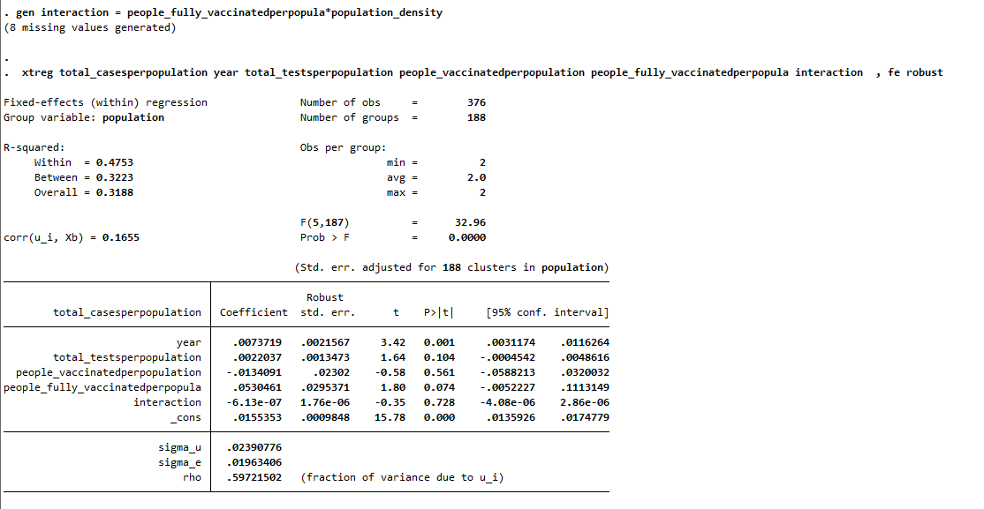
Adding interaction terms contd….
interaction = people_fully_vaccinatedperpopulation*population_density

Slide 10
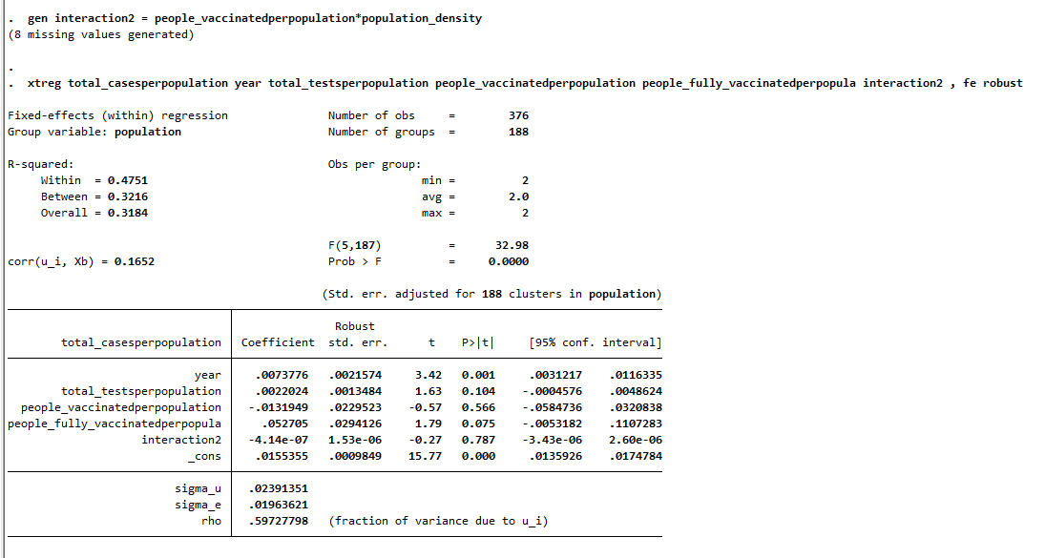
Adding interaction terms contd….
interaction2 = people_vaccinatedperpopulation*population_density

Slide 11
Interpretation of results
As per the fixed affect model-
The ratio of cases per population increased by 0.0066 from 2020 to 2021.
Increase in ratio total test per population by 0.5 increases total cases per population ratio by 0.00109.
Increase in ratio fully vaccinated per population by 0.5 increases total cases per population ratio by 0.0281.
0.002
0.104
0.049

Slide 12
Interpretation of results
As per the models with interaction terms-
The first interaction model with total_testsperpopulation, population_density, the interaction term has a P value of 0.019 which makes it significant.
The affect of total test per population on total cases per population would be-
0.0024 + 0.0000012 population_density
This means one unit increase in total_testperpopulation would increase total cases per polutation by 0.0024 + 1.2e⁻⁶ x population density

